Slide 1
one question
“How did your open enrollment go this year?”
Additional Questions To Ask:
If you had 20 minutes to spend with each of your employees, what would you want to tell them?
Do your employees understand and appreciate the value of their benefit plans? Do they realize the employer cost associated with their benefits package?
Are all of your benefits communicated effectively? Does your current enrollment system provide benefit education and decision support?
Do you believe your employees are enrolled in appropriate benefit plans to meet their specific needs?
Are you looking for ways to improve your healthcare strategy without increasing costs?
Would you like to help your employees offset increasing healthcare costs?
Is the ability to attract and retain talent by offering a competitive benefits package important to you?
Could you use additional resources and support to manage open enrollment?
What participation goals do you have for your health & welfare plans?
When was the last “active” enrollment? Is your employee demographic data up-to-date?

Slide 2
Getting the Conversation Started
Clients looking to improve their overall enrollment process and strategy. Clients making Core Benefit plan changes. Introducing a new HDHP or trying to drive migration into a high deductible plan. Changes to the co-insurance, deductibles or surcharges (wellness, spousal, tobacco, etc.) that employers anticipate may upset employees. Clients looking to better communicate with their employees. Clients needing to deliver a clear consistent benefits message to employees. Spread out/difficult to reach workforce. Multilingual employees. Clients managing mergers and acquisitions with different systems and/or core benefit designs. Client in need of cleansed employee data. Clients interested in adding voluntary benefits as a way to strengthen their benefits package in order to attract and retain quality employees. Clients with existing suite of Voluntary Benefits with low participation and little connection to the overall financial wellness of the employees. Clients considering changes to existing voluntary benefits through a market analysis.

Slide 3
VBES Sales Organization
Dani McCauley
National Sales Leader
Dennis Lyons
Danielle Crea
Jason Krouse
Western Sales Leader
Tina Young
Marketing Manager
David Nguyen
Eastern Sales Leader
Sales Admin
Sales Admin
Bruce Sletten
Marc Lower
Shared
Services
Chip Balser
Chris Champa
Tier 2 Sales
CA, OR, WA
FL, GA
Public Sector Sales
Erik Western
Shawn Seamonds
Sales Project Manager (Legal & Compl.)
Scott DiGerolamo
Joe Prendergast
< 1,000 Sales
IL, WI, MN
NY, NJ
<< 1,000 Sales
Mark Murdock
Ed Bell Solution Architect
Karen Koons
TX
SC, NC, VA, DC
Tim Colton
Solution Architect
Mike Parrott
CO, AZ, NM, MO
MI, IN, OH, TN
Solution Architect
Joe Mazzeo
PA
Andrew Meader
NE, CT
Notes:
34,147,206

Slide 4
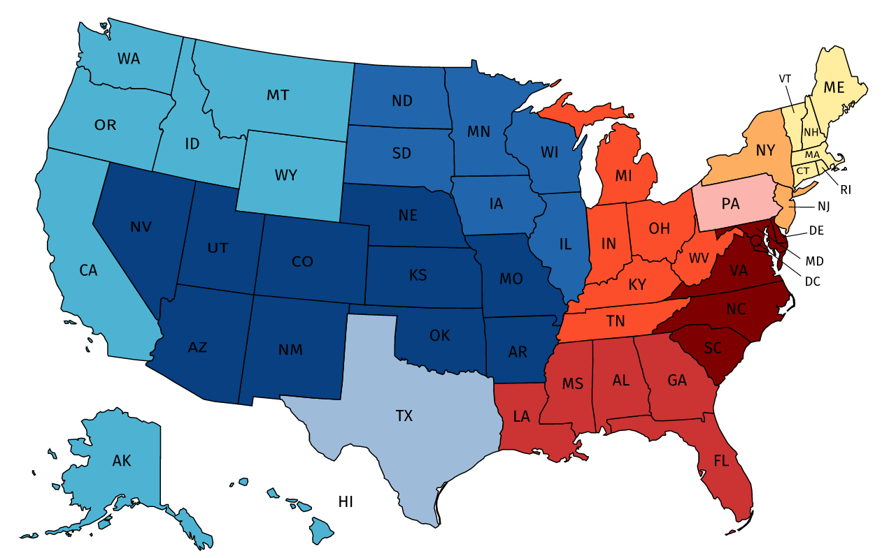
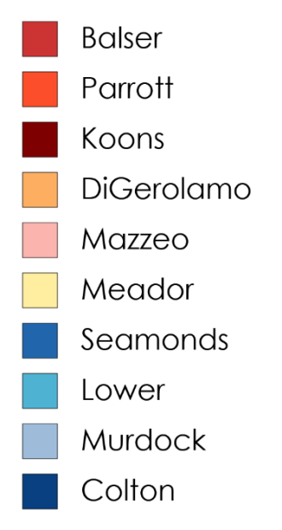
Consultants In Your Market

